Slide 1




Ministry of Electronics & Information Technology
National Informatics Centre
Kerala State Centre
K-SWIFT
Single Window Interface for Fast & Transparent Clearance
Digital Signature Integration
A Joint Initiative of KSIDC, Govt. of Kerala & National Informatics Centre

Slide 2
DSC Registration
All the officers who are designated for Approving Licenses/Permits digitally using K-SWIFT should have Digital Signature Certificate (DSC) got issued in their own name. The users will have to Register the DSC with KSWIFT (one-time activity) before using it for digital signing.

Slide 3
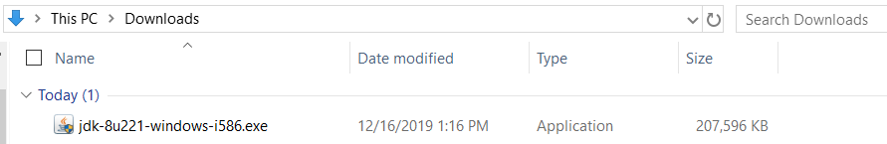
Step 1 - Download the Java Install File to Your Computer
A supported version of Java will need to be downloaded to your computer before it can be installed. Please refer to the Oracle website or another provider to download a supported version.
Step 2 - Install Java on your Computer
Double click on the Java install file within your Downloads folder.

Slide 4
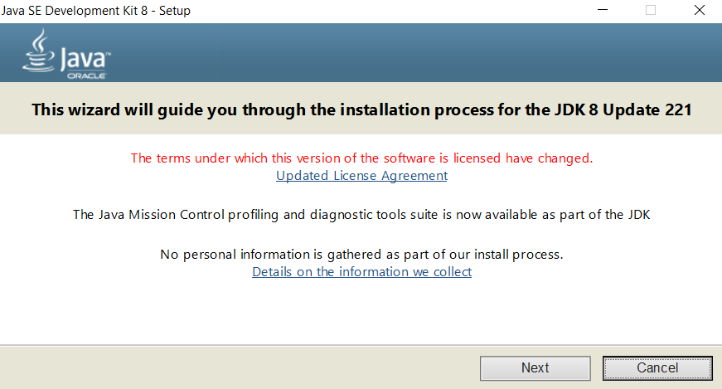
Click Next in the Installation Wizard to continue.

Slide 5
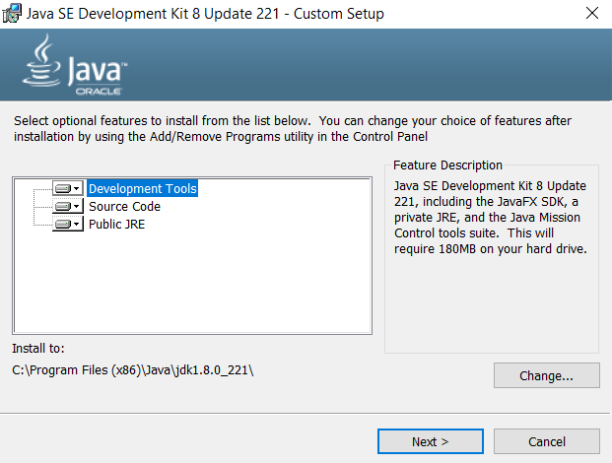
Here, you can choose optional features to include within the installation or change the default installation directory.
Click Next to continue.

Slide 6
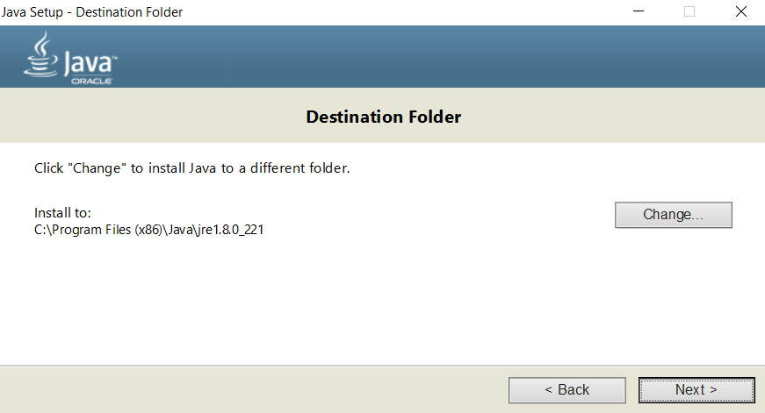
Note: Click the Change button to change the install path.
Click Next again to begin the installation.

Slide 7
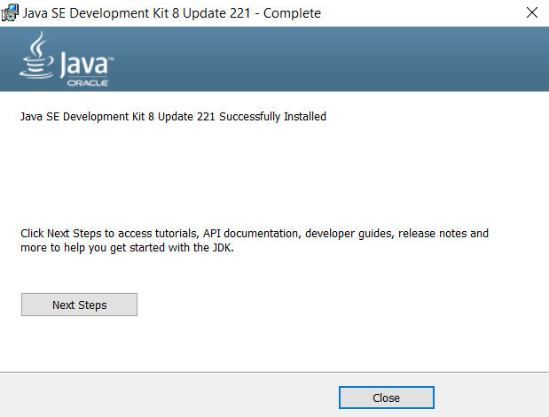
Click Close to close the install window.

Slide 8
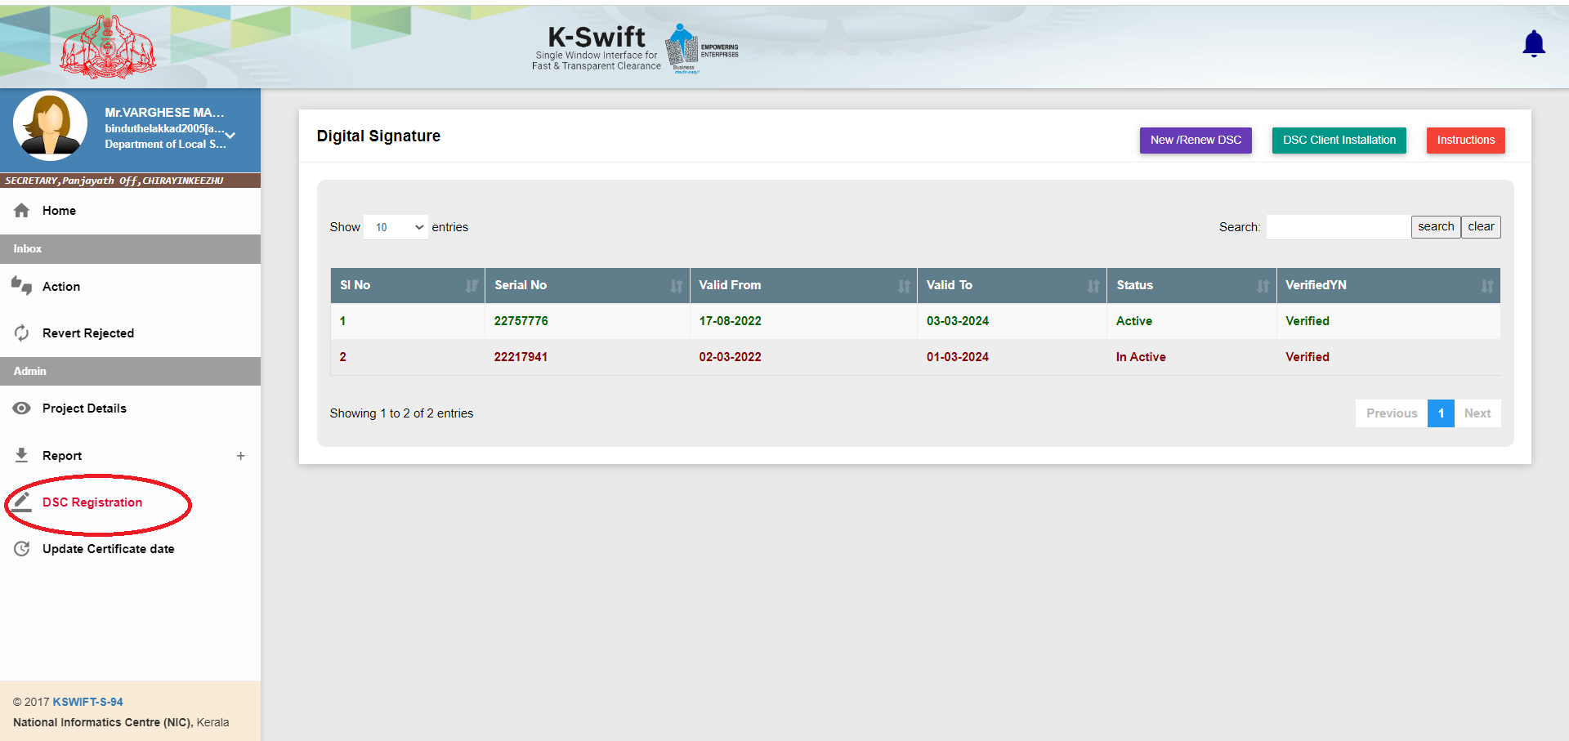
K-SWIFT
www.kswift.kerala.gov.in
Select “DSC Registration” from Menu

Slide 9
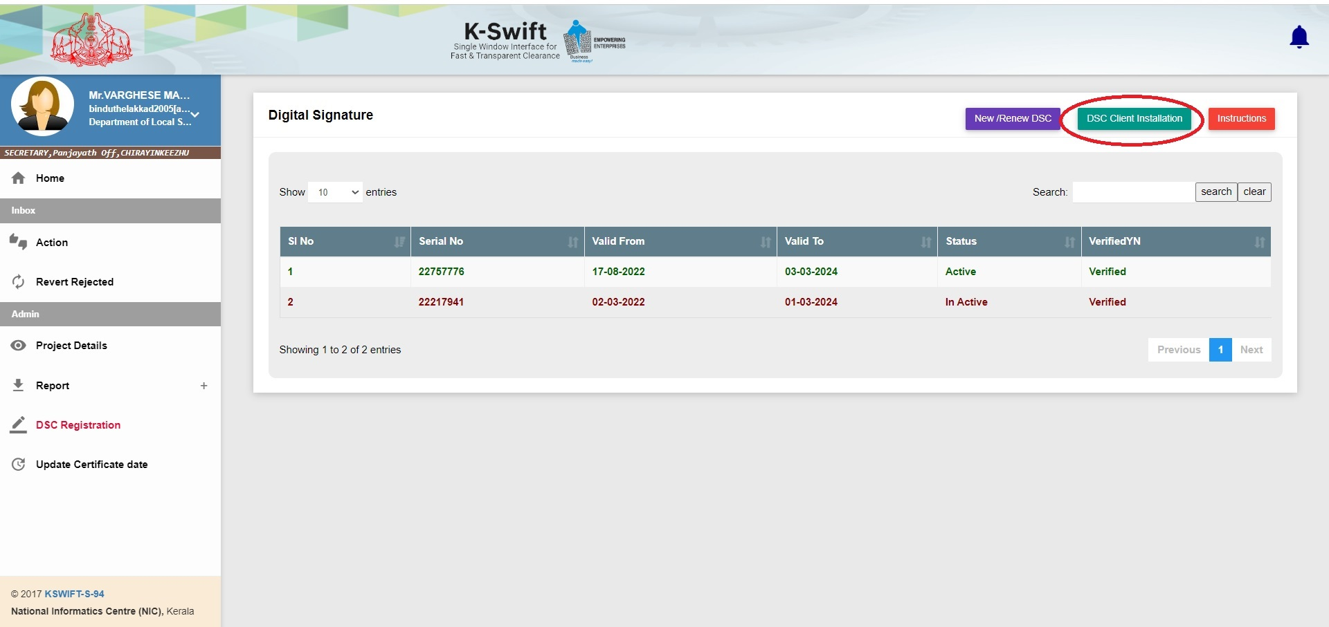
K-SWIFT
www.kswift.kerala.gov.in
Click the “DSC Client Installation” button to download the appropriate signer tool & manual as per the Operating System (OS)

Slide 10
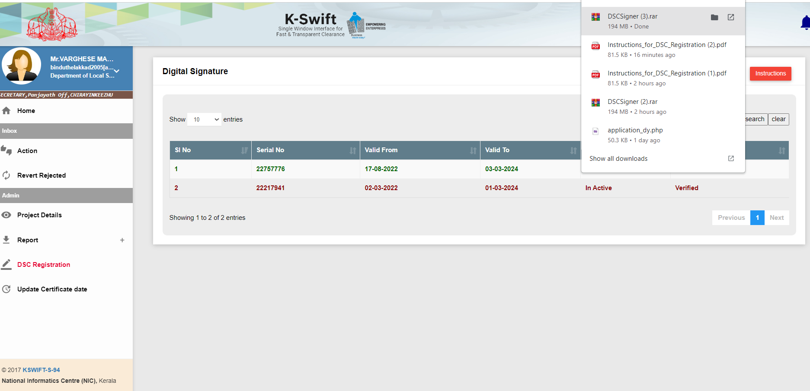
K-SWIFT
www.kswift.kerala.gov.in
Unzip the folder to get the DSC signer installation manual of the OS. Follow the procedure as given in the installation manual.

Slide 11
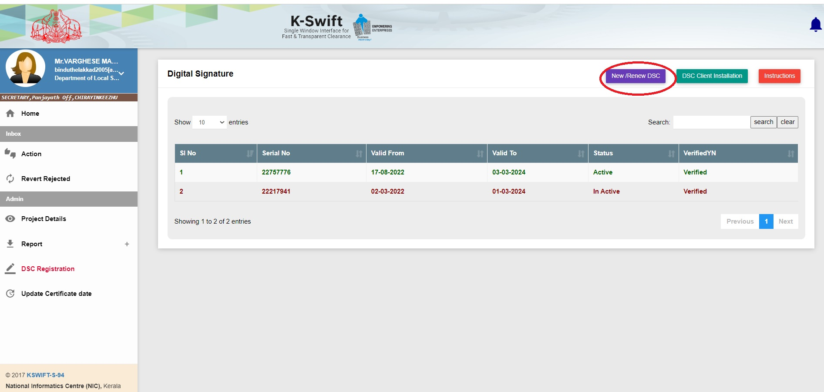
KSWIFT
www.kswift.kerala.gov.in
After completion of the above steps, insert the DSC to the USB port of your computer
Click on the < New /Renewal DSC> button to register DSC.

Slide 12
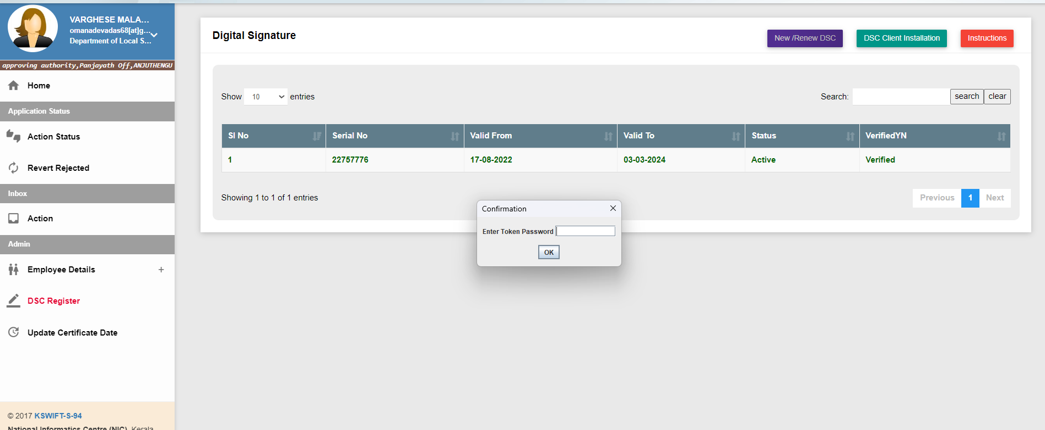
K-SWIFT
www.kswift.kerala.gov.in
Enter PIN of DSC when prompted.

Slide 13
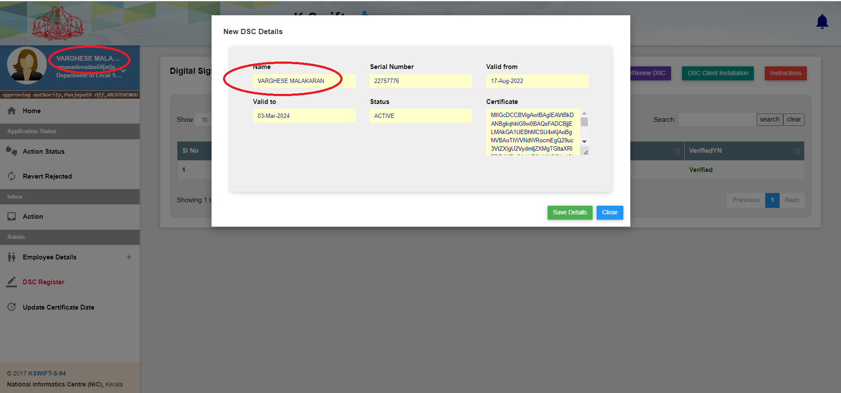
If the DSC registered name and the logged user name are matching, DSC registration will be completed successfully, otherwise error message will be flashed.

Slide 14
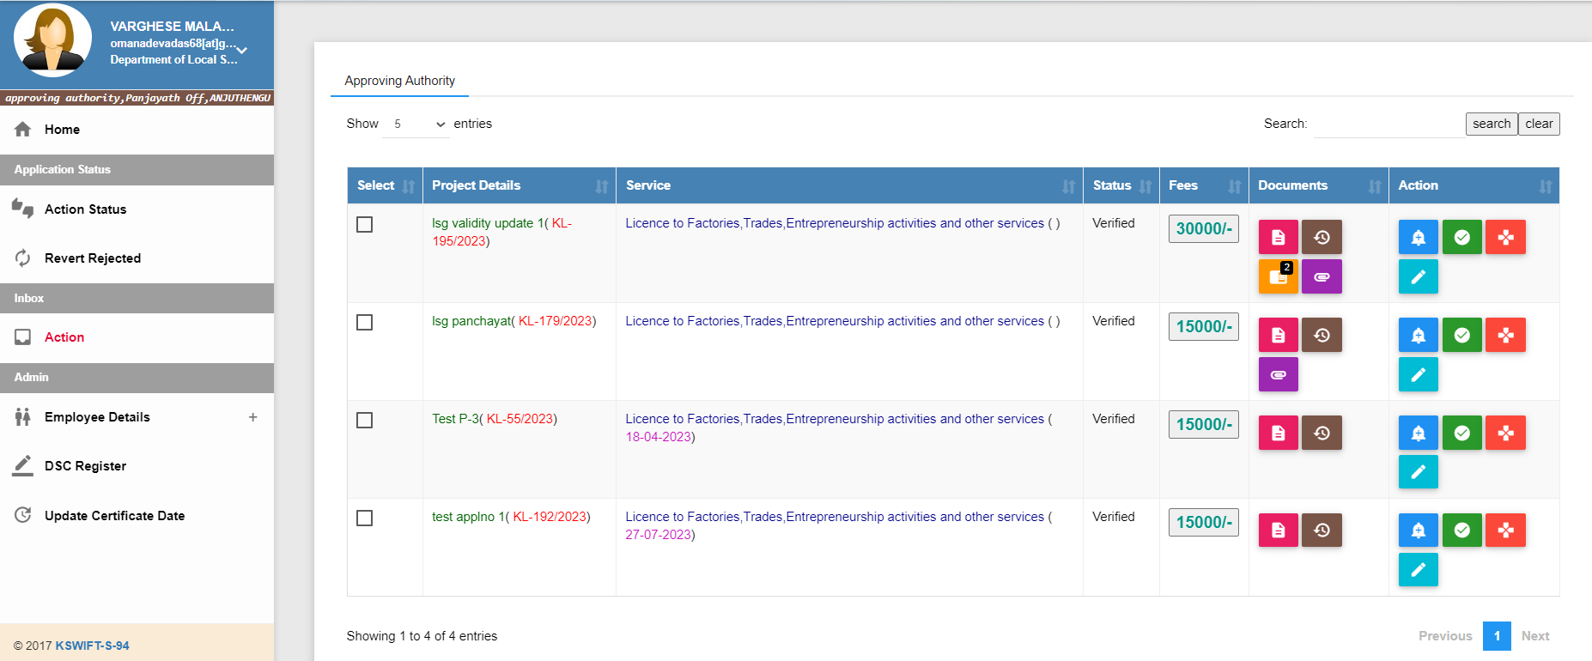
Click this button

Slide 15
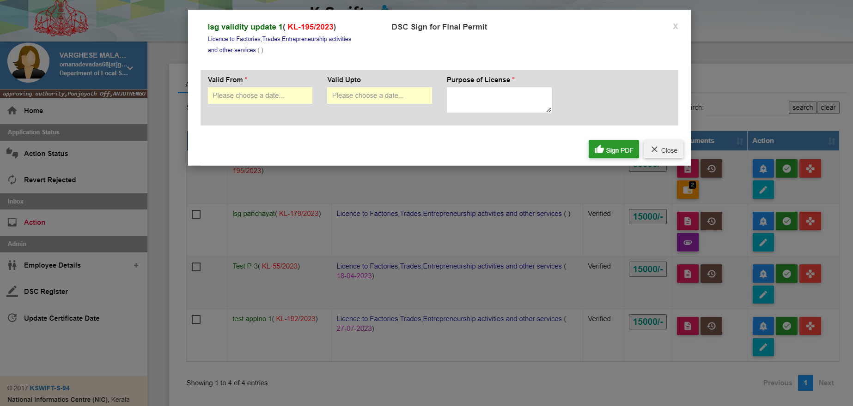
Click the sign PDF button

Slide 16
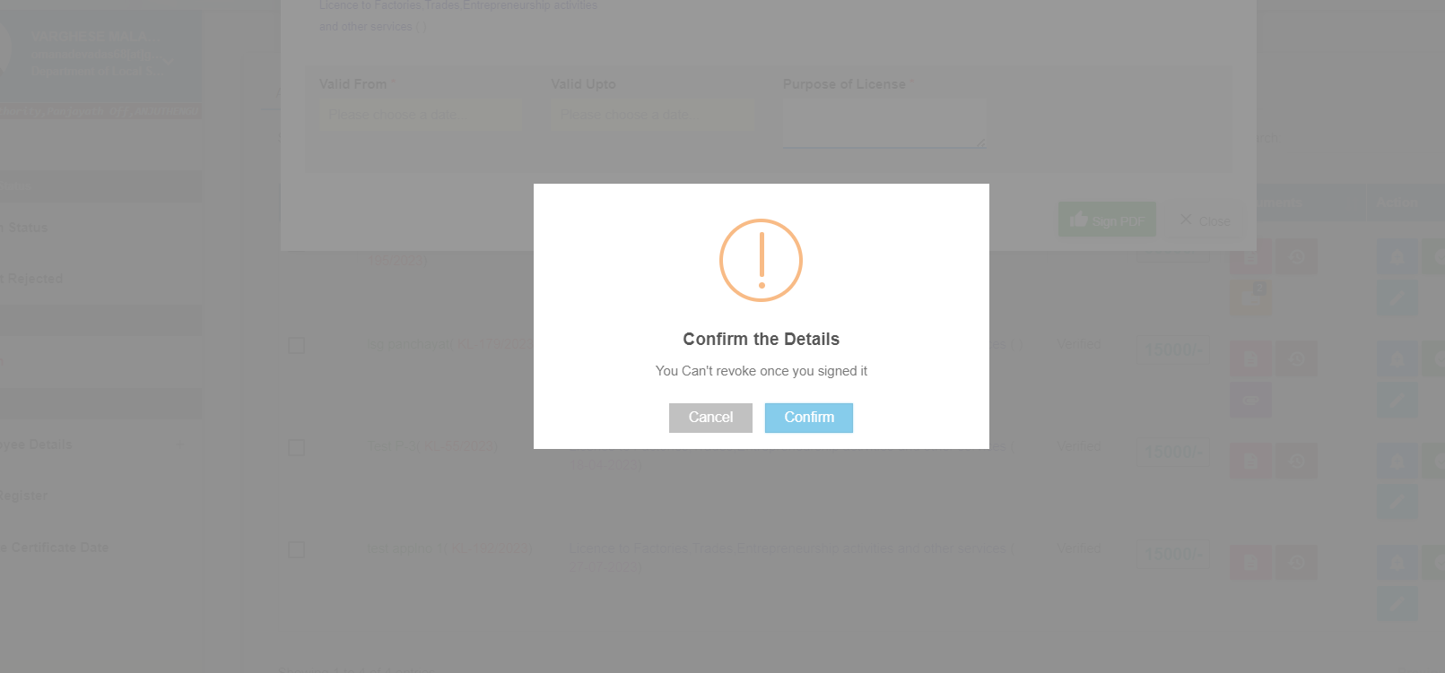
Confirm the certificate details

Slide 17
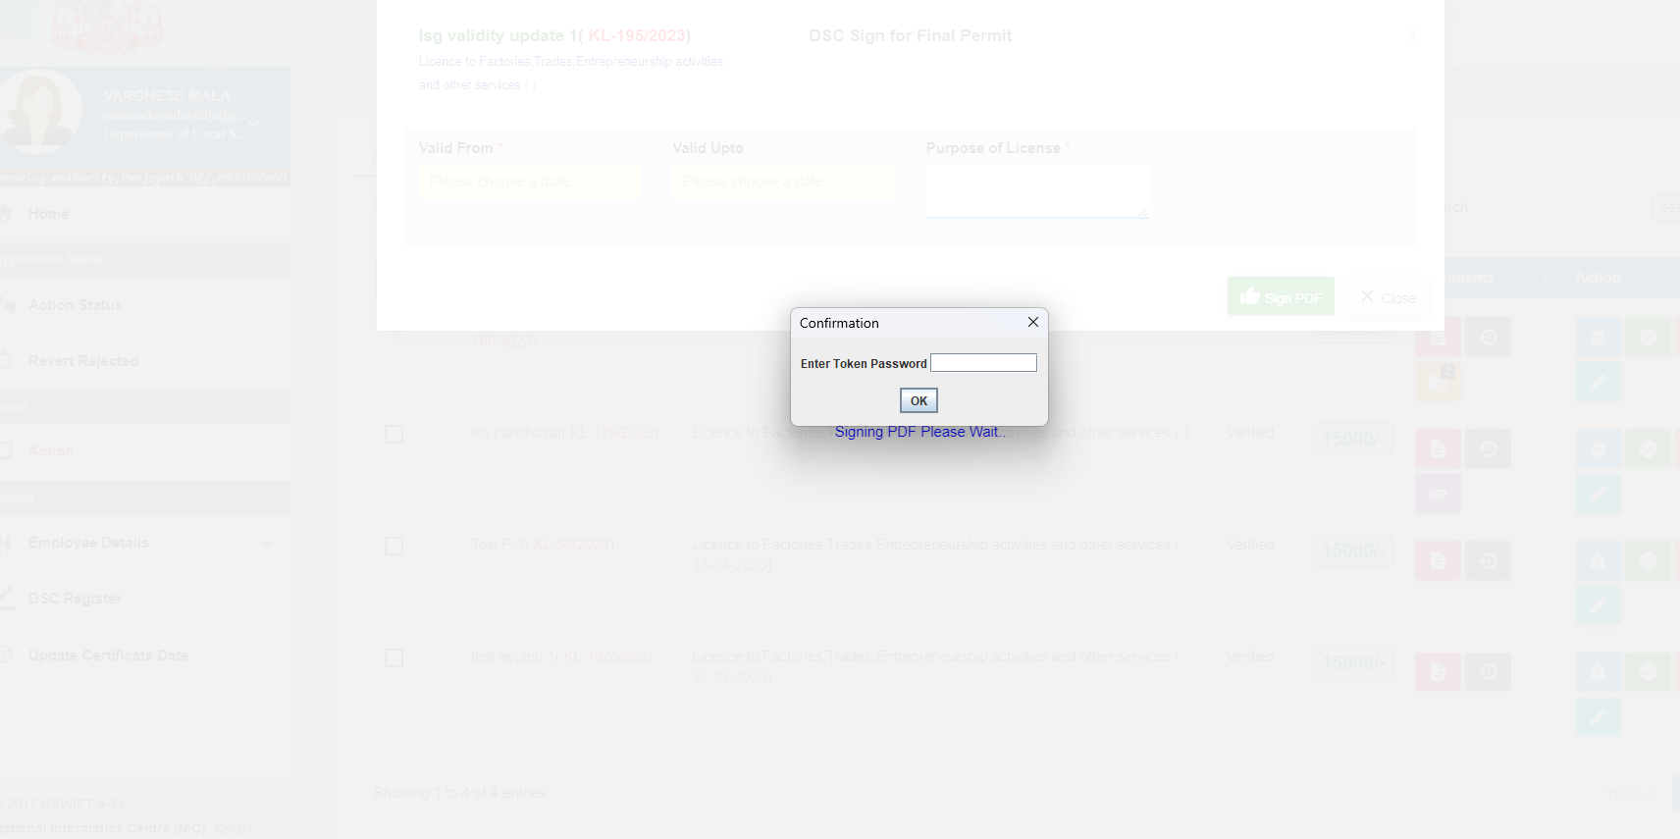
Enter PIN of DSC when prompted

Slide 18
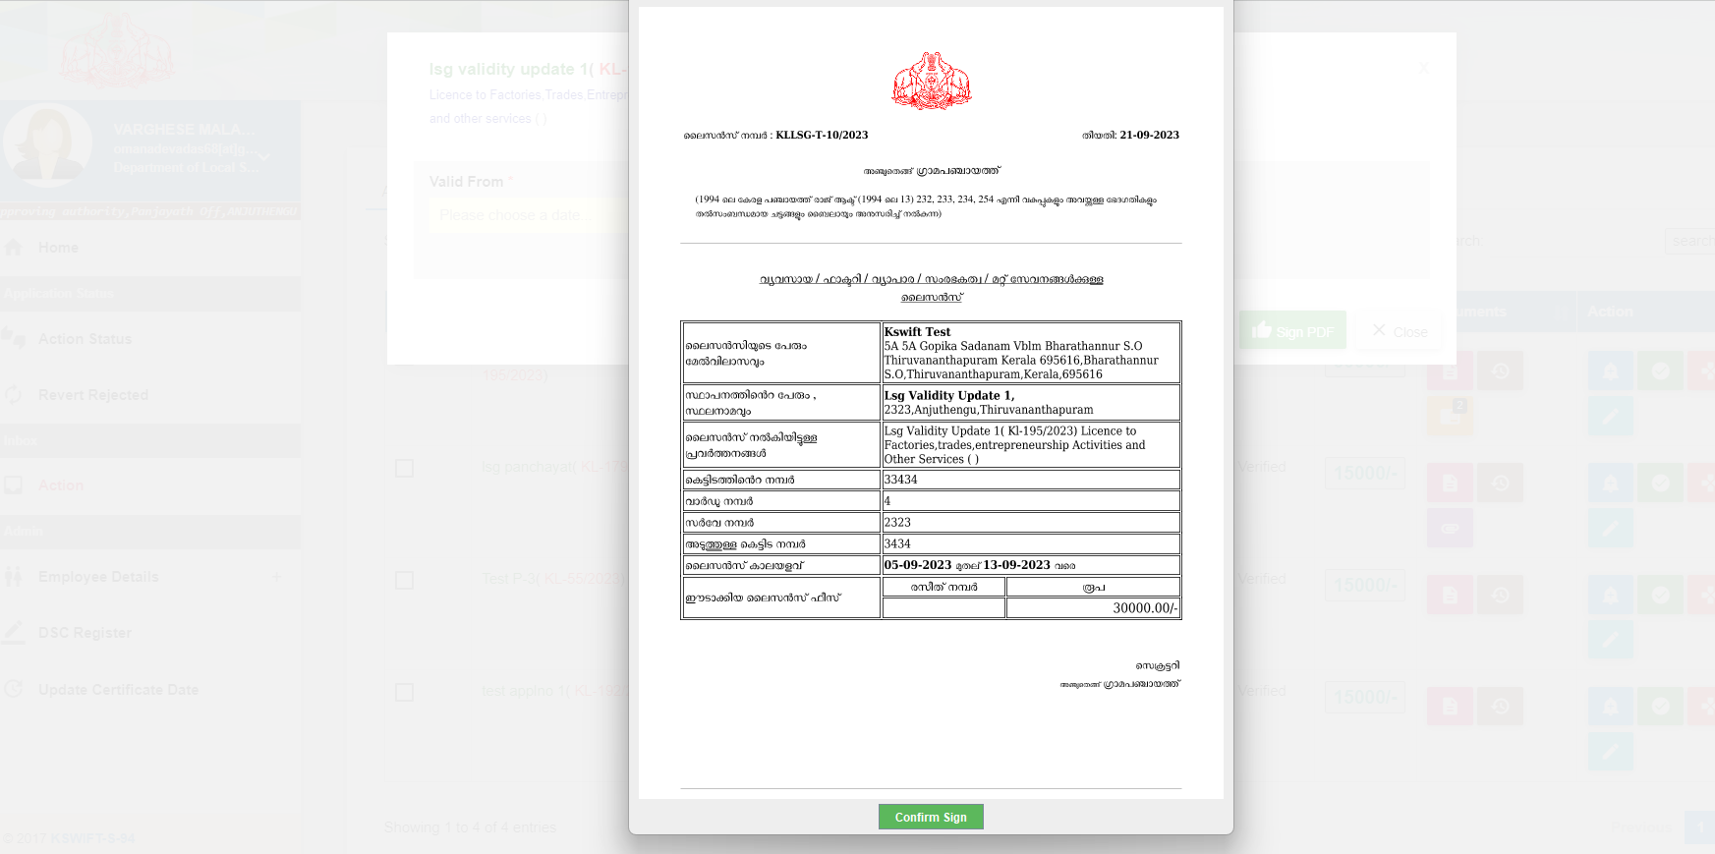
Click the confirm sign to generate the certificate

Slide 19
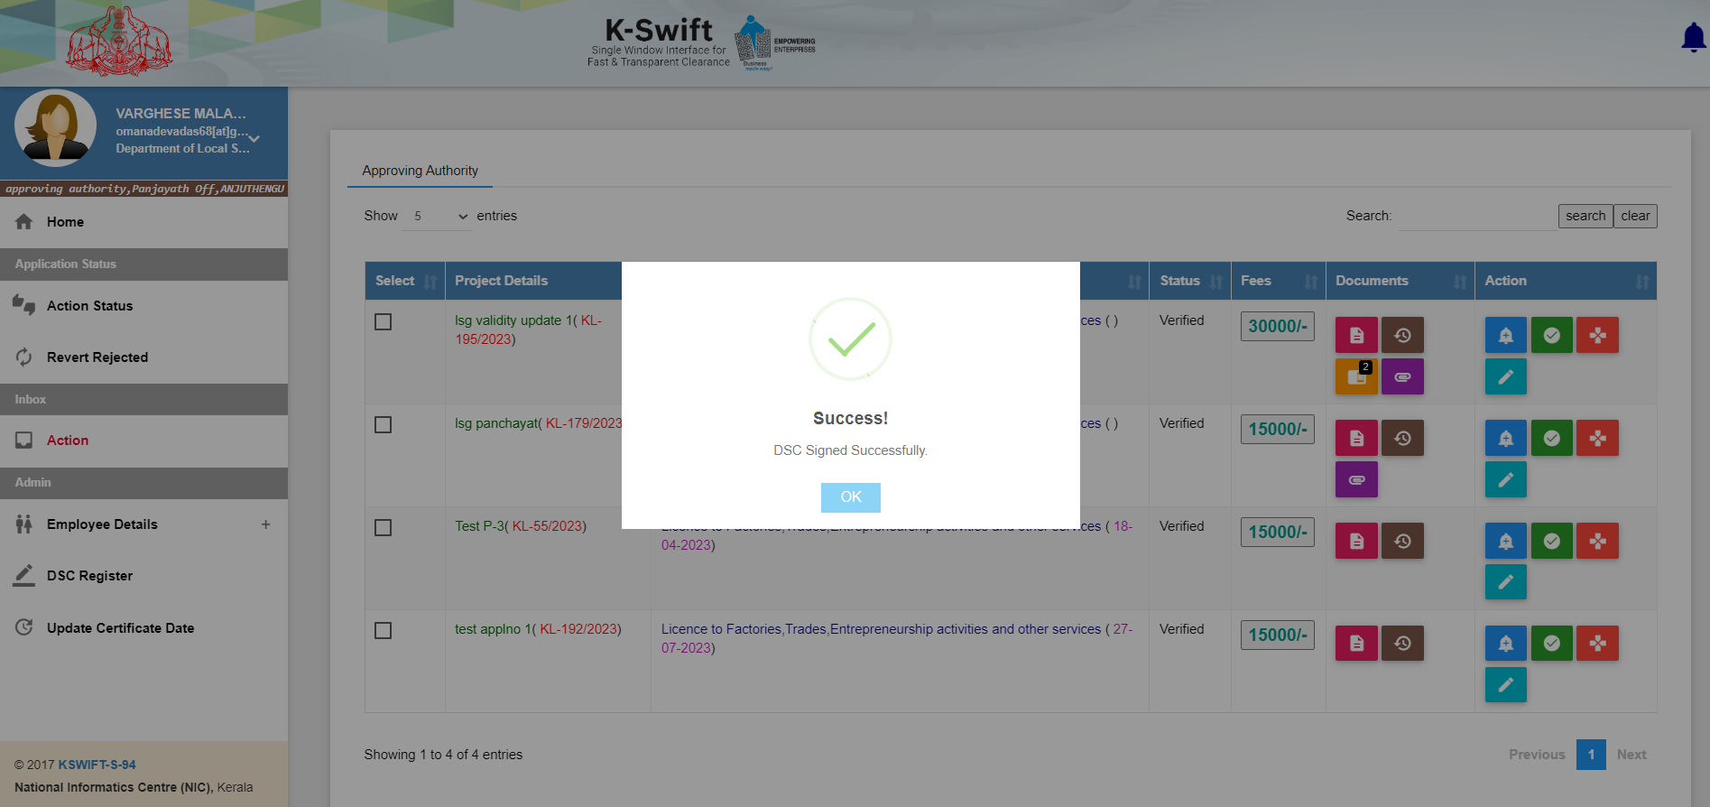

Slide 20
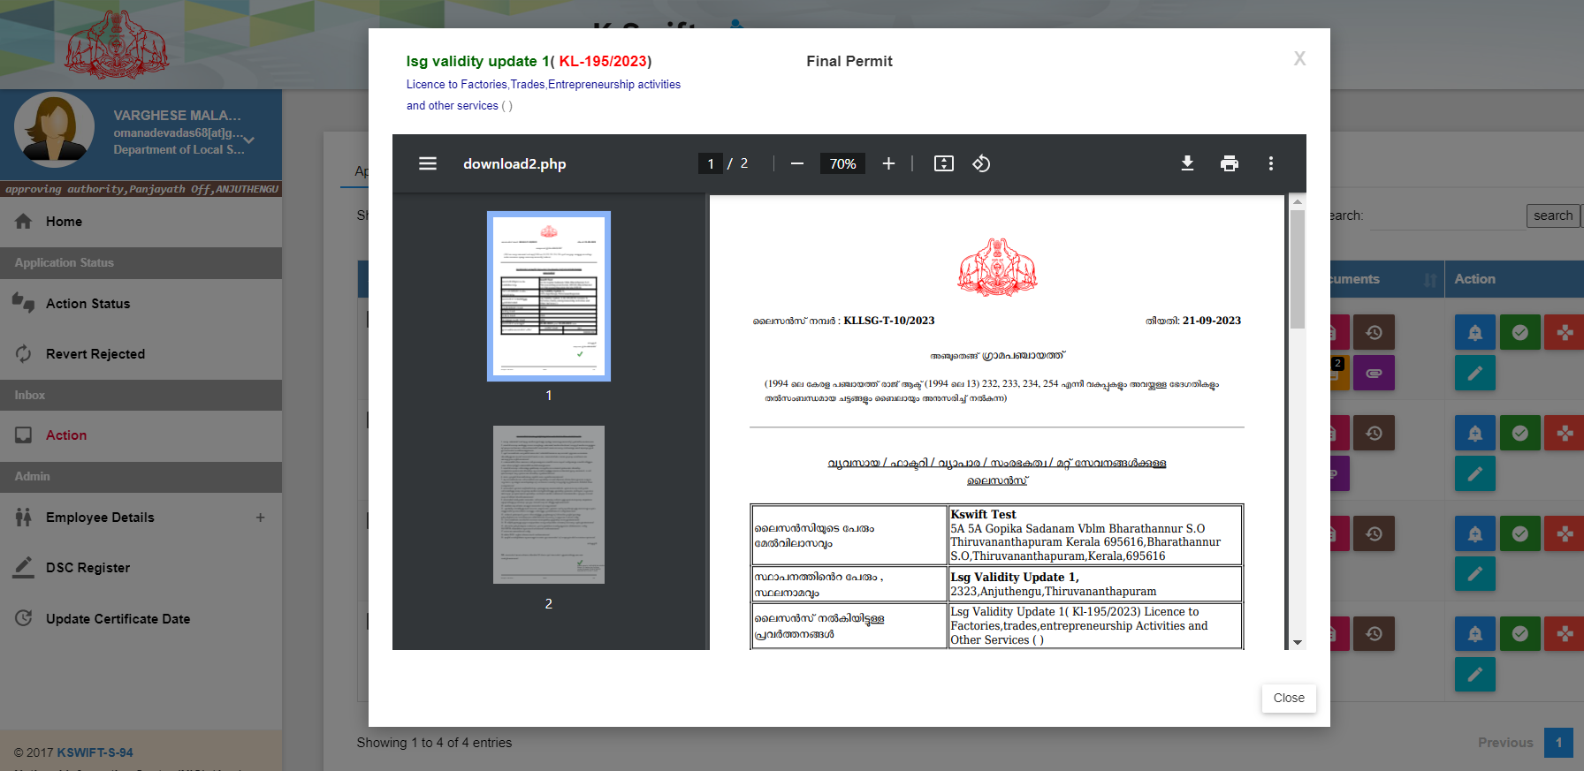

Slide 21
